Slide 1

Twitter & Ontime
Analysis
Kai Wei Yeh, Sheng Yang Chou, Zinnia Arshad
Alec Billstrand, Erika Ergart

Slide 2
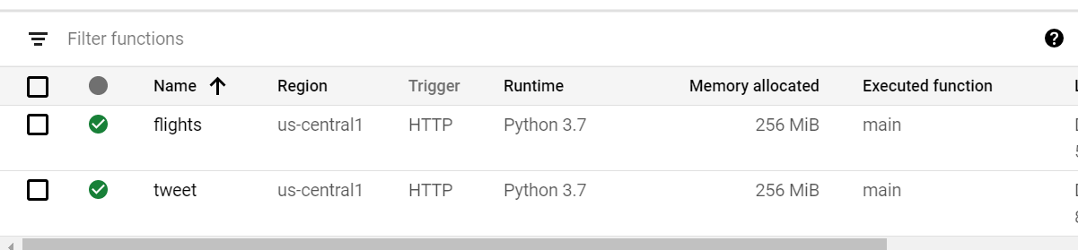
Cloud Function

Slide 3
Function Tests
Flights
{"bucket":"flights_api_twitter","path":"datadump","separateLines":"True","debug":10}
Tweets and Users
{"message":{"query":["American Airlines", "United Airlines", "Delta Airlines"],"limit":100,"projectId":"twitter-298321","topic":"twitter","userTopic":"user_twitter","bucket":"flights_tweets","userBucket":"user_tweets"}}
{"message":{"query":["American Airlines", "United Airlines", "Delta Airlines"],"limit":100,"projectId":"twitter-298321","topic":"twitter"}}
{"message":{"query":["American Airlines", "United Airlines", "Delta Airlines"],"limit":100,"projectId":"twitter-298321","topic":"user_twitter"}}

Slide 4
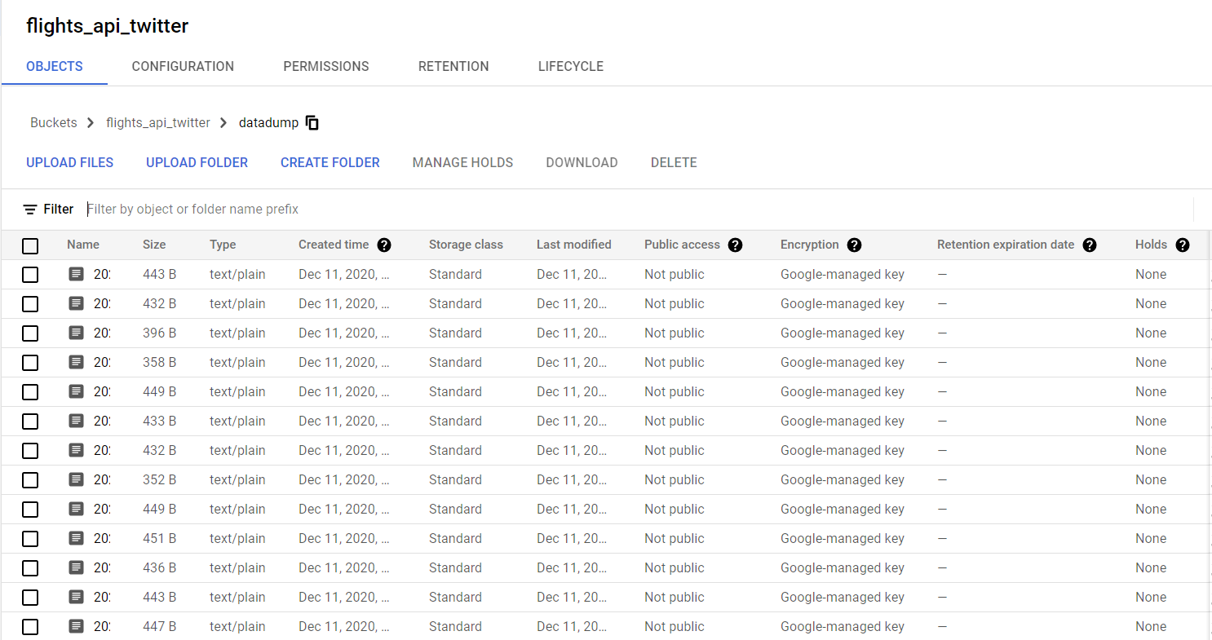
Storage
Flight Data

Slide 5
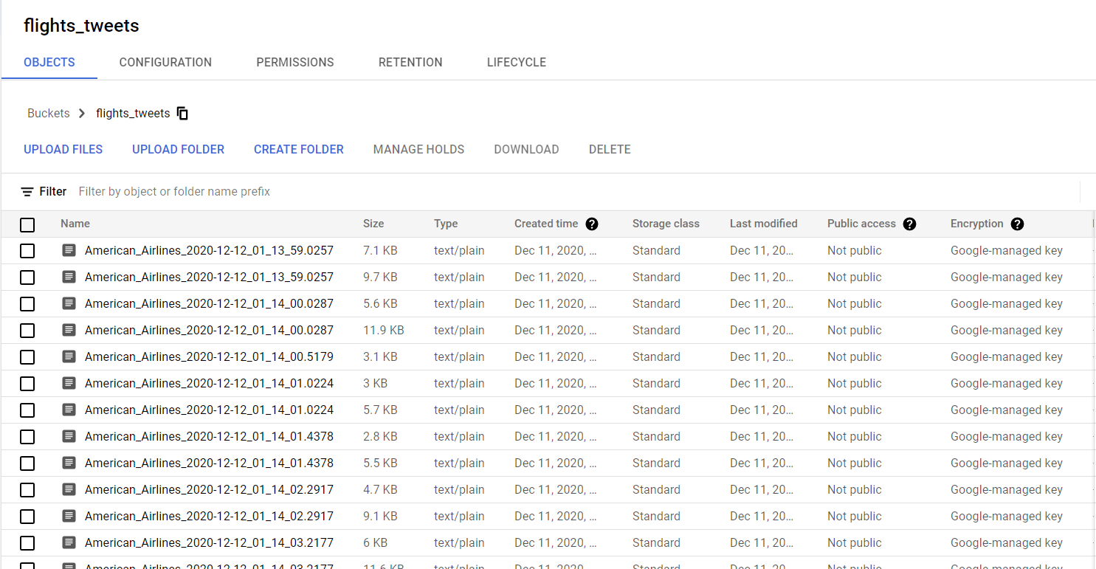
Storage
Twitter

Slide 6
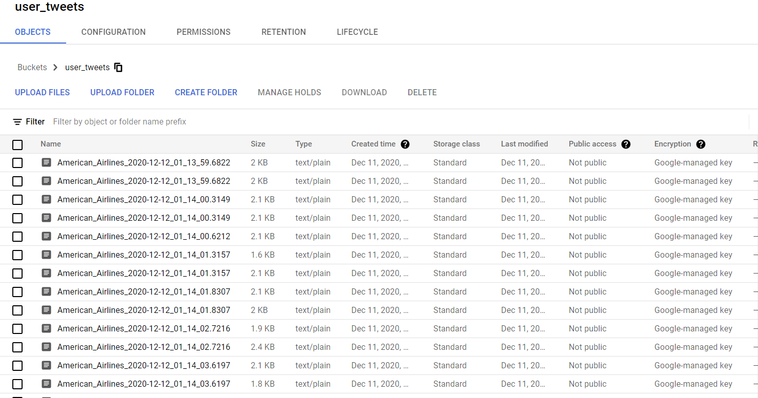
Storage

Slide 7
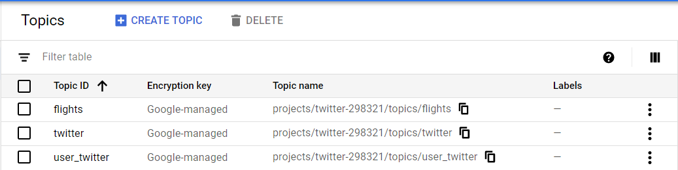
Topics

Slide 8
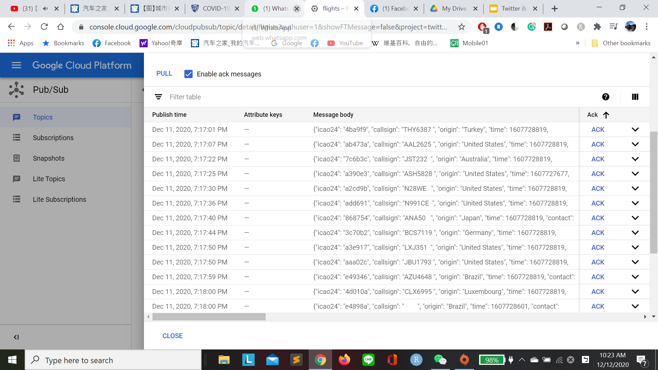
Pubsub Topics-Flights

Slide 9
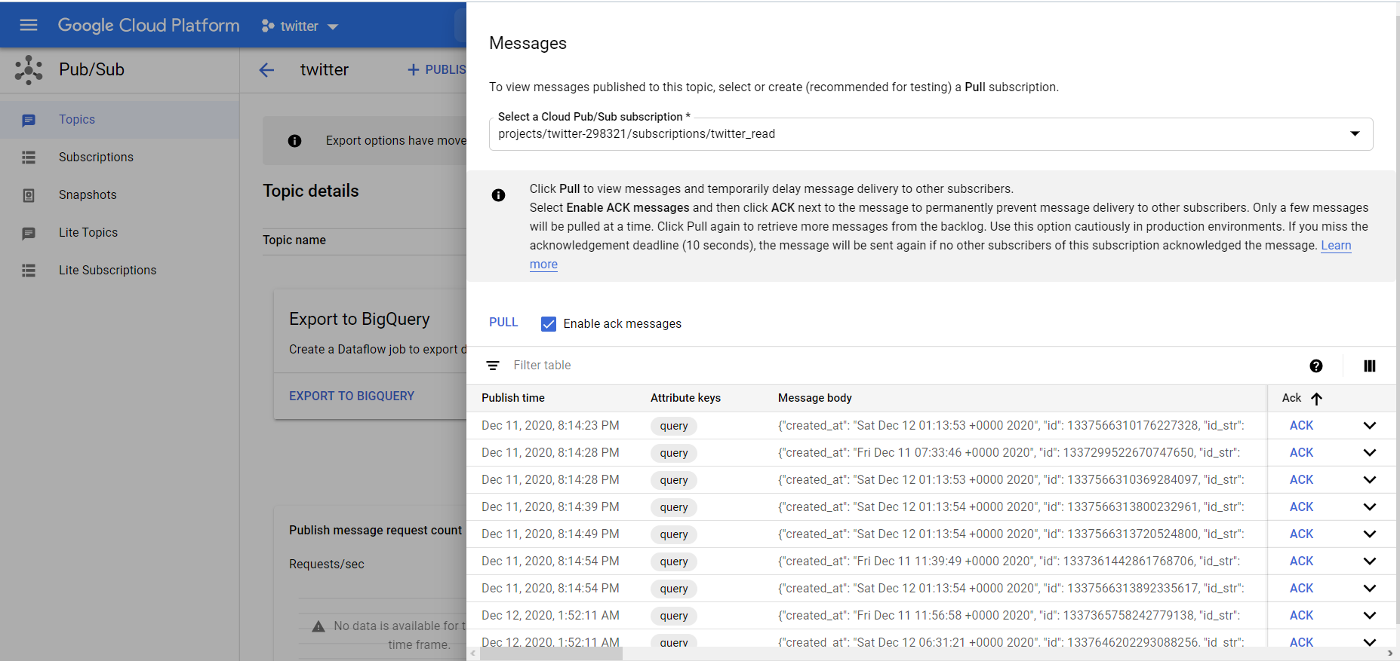
Pubsub Topics-Twitter

Slide 10
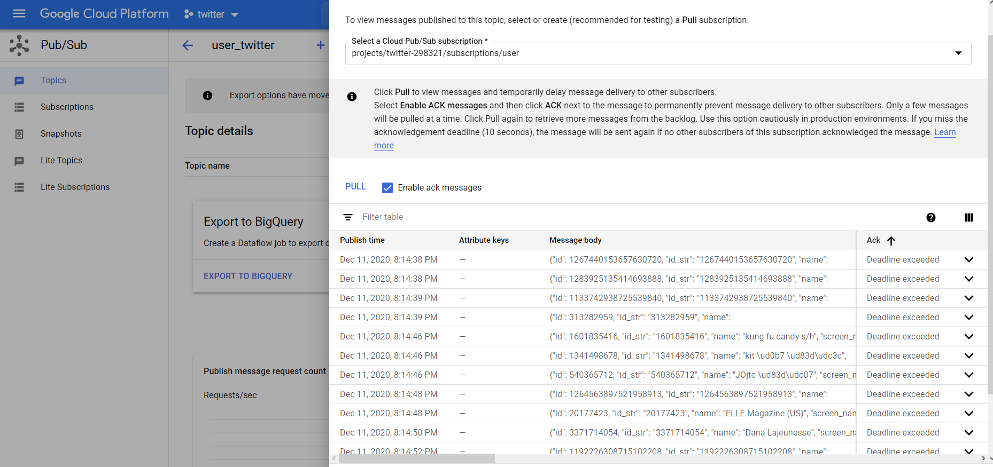
Pubsub Topics-Twitter Users

Slide 11
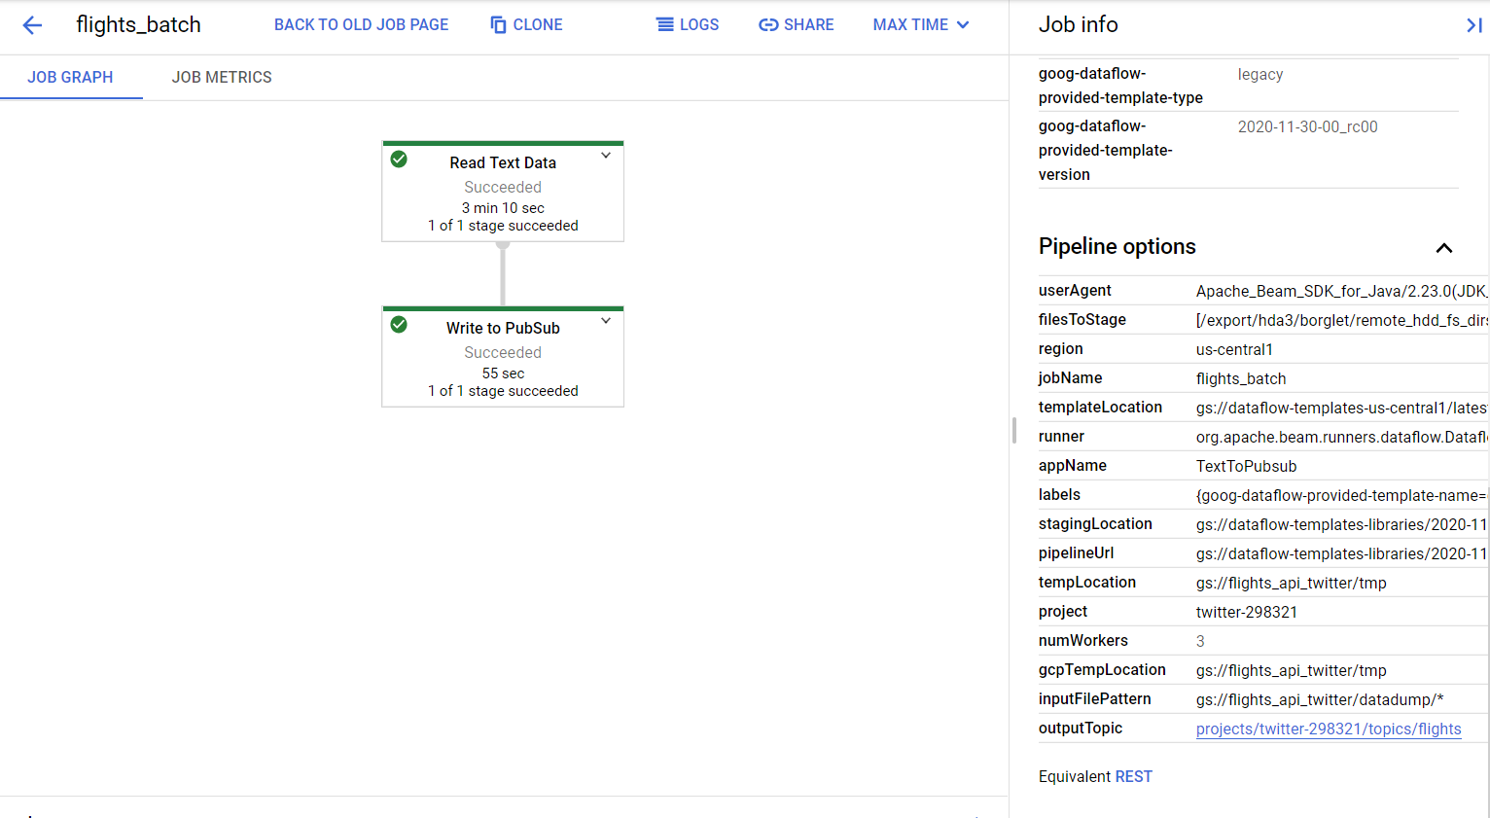
Dataflow-Flights (Batch)

Slide 12
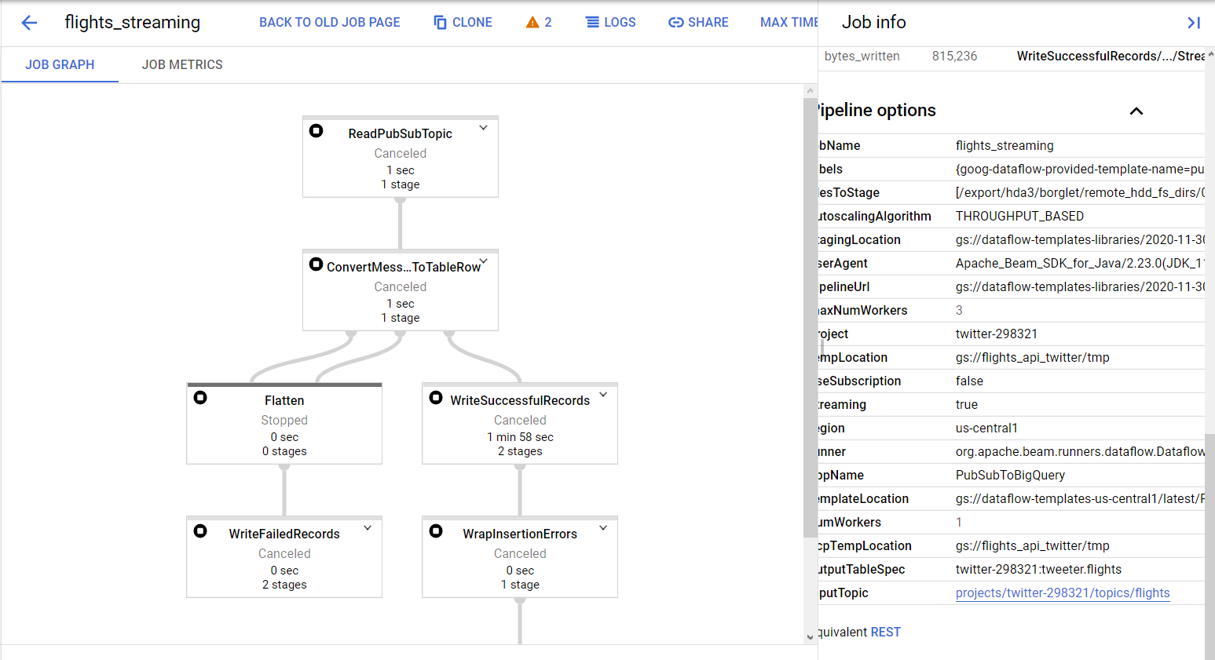
Dataflow-Flights (Streaming)

Slide 13
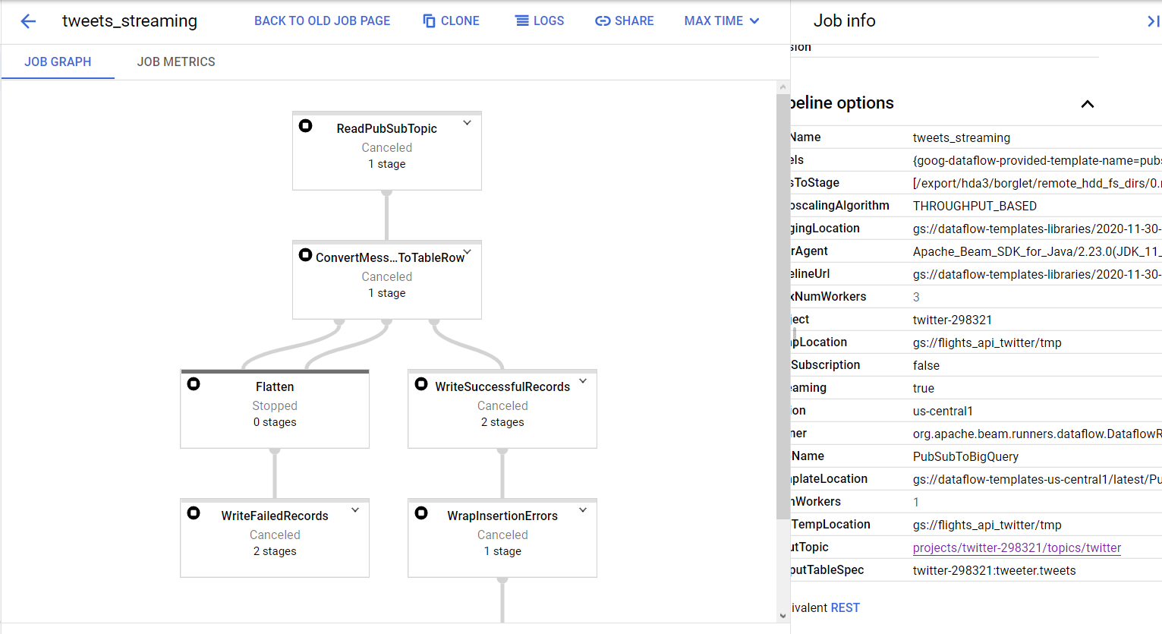
Dataflow-Twitter (Streaming)

Slide 14
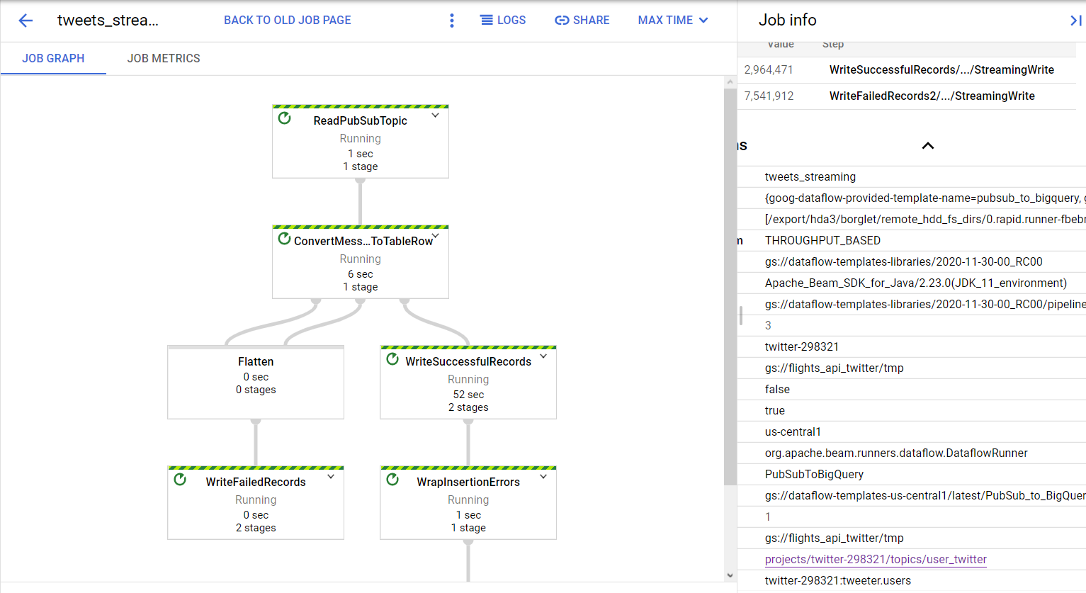
Dataflow-Twitter Users (Streaming)

Slide 15
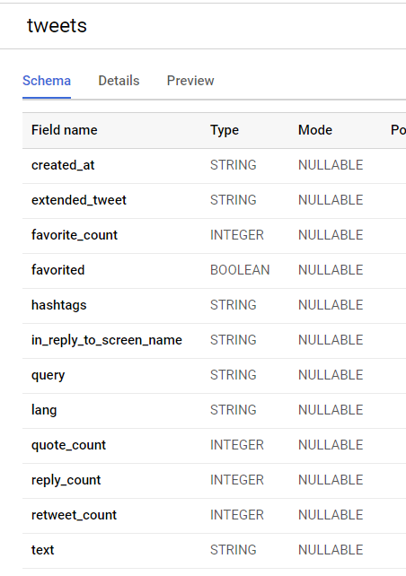
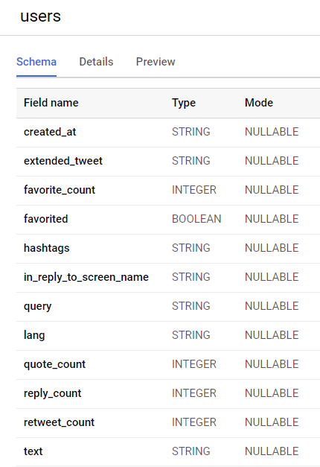
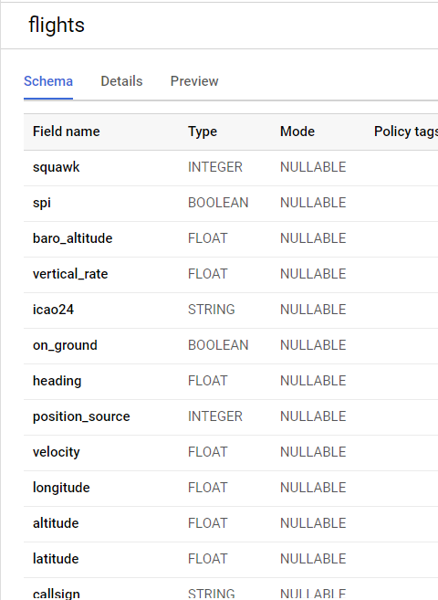
Schema - Tables (Twitter, Twitter Users, and Flights)

Slide 16
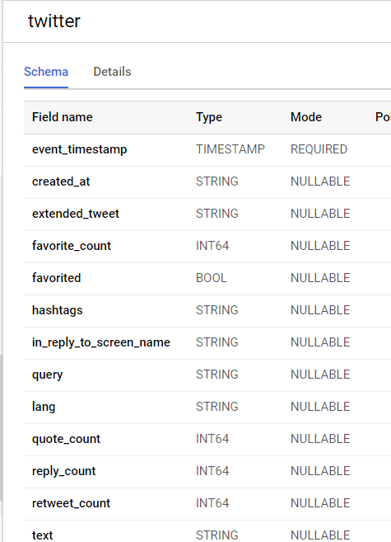
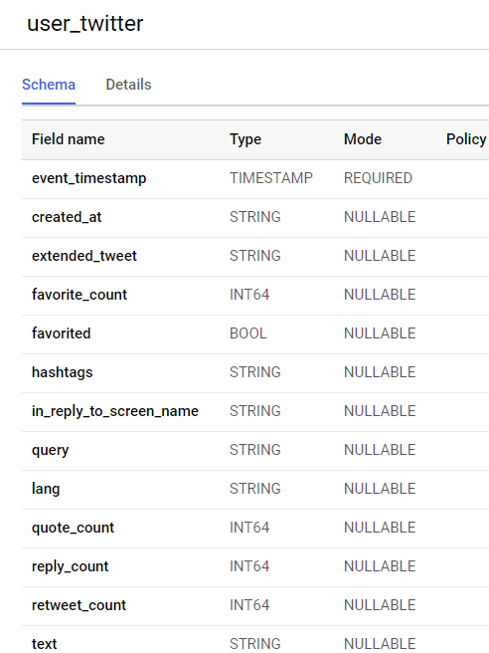
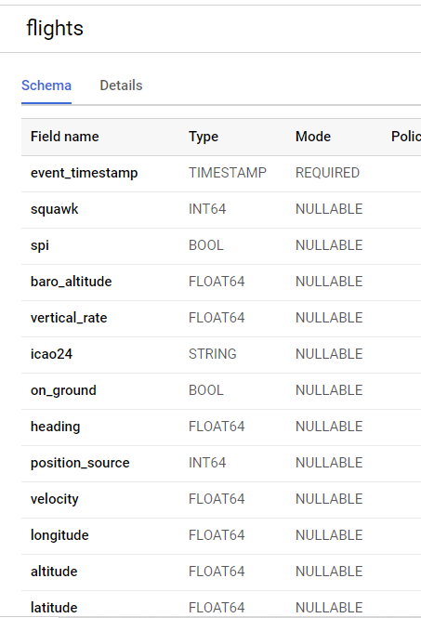
Topics Schema (Twitter, Twitter User, and Flights)

Slide 17
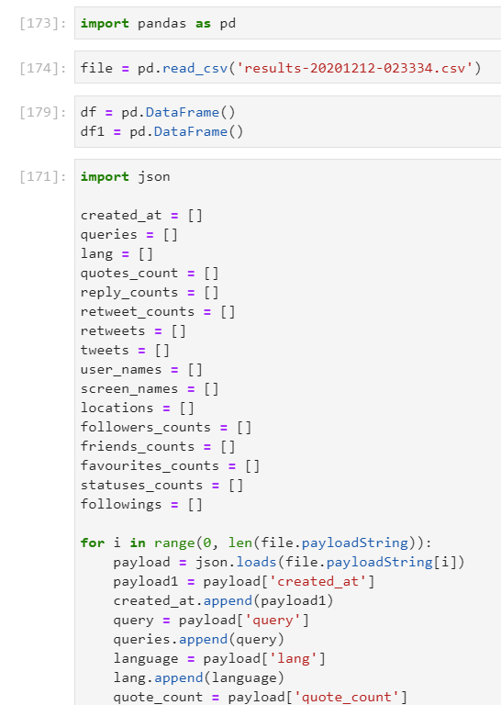
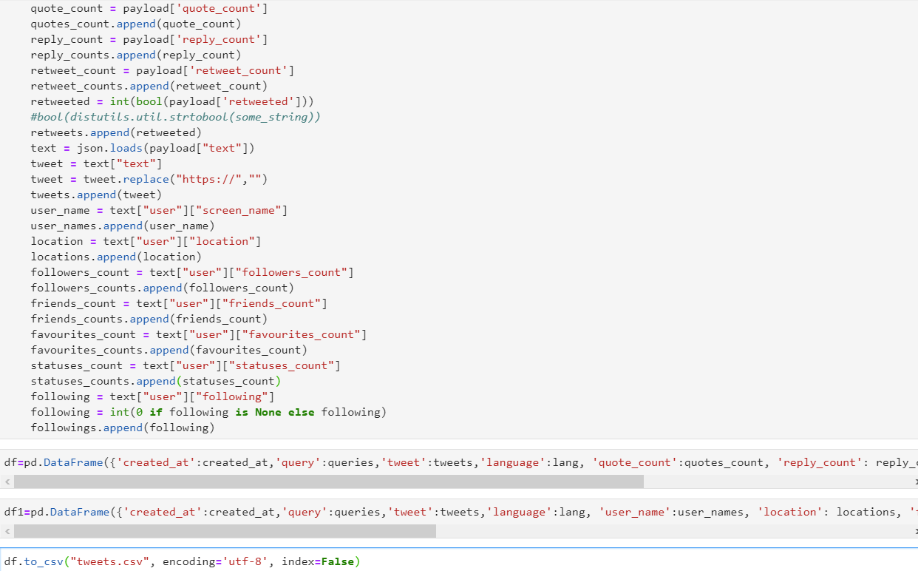
Fixing Data Formats (Python Code) - Train Data

Slide 18
Final Tables
Flights: flights (training) & flights_new(test)
Twitter: tweets_corrected(training) & tweets_corr_new(test)
Users: users_corr(training) & users_corr1 (test)

Slide 19
Machine Learning

Slide 20
Model Creation and Evaluation for Status Count- Linear Regression
CREATE OR REPLACE MODEL `tweeter.user`
OPTIONS
(model_type='linear_reg', input_label_cols=['status_count']) AS
SELECT
status_count,language, followers_count, favourites_count, friends_count
FROM `twitter-298321.tweeter.users_corr`
WHERE status_count IS NOT NULL

Slide 21
Model Prediction and Evaluation for Status Count- Linear Regression
SELECT * FROM ml.predict (model `tweeter.users`,
(SELECT language, followers_count, status_count, favourites_count, friends_count
FROM `twitter-298321.tweeter.users_corr1`
WHERE status_count IS NOT NULL))
Judging from the R^2 scores for the training and test data sets, R^2 score decreases, which means that there is a better model that would predict status_count variable as opposed to the currently displayed one

Slide 22
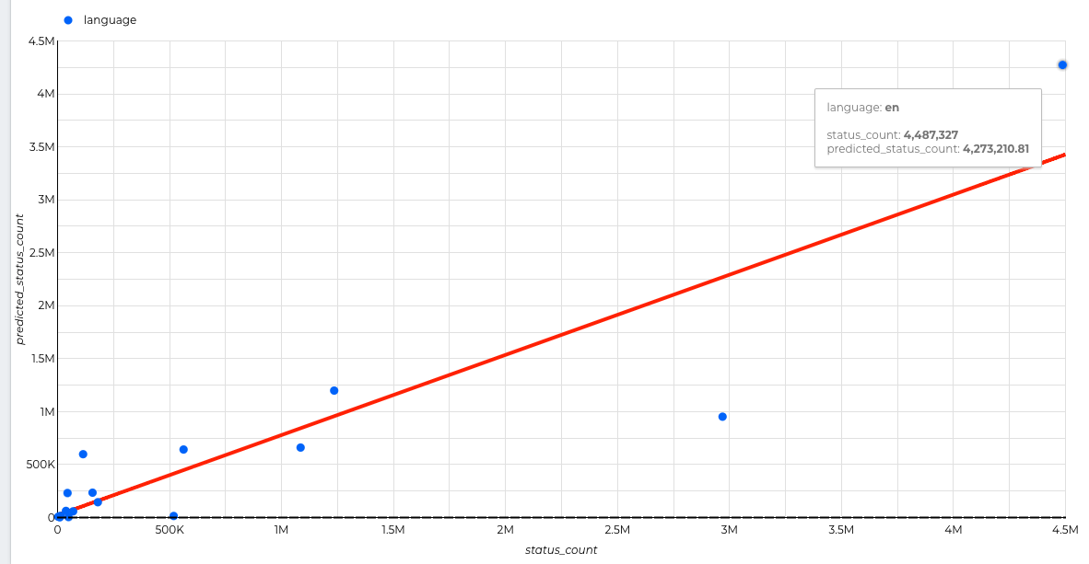
Status Count
English has the most number of status counts followed by Spanish

Slide 23
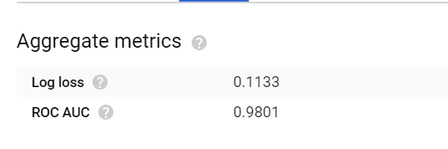
Model Creation and Evaluation for on-ground analysis
CREATE OR REPLACE MODEL `tweeter.delaypredict`
OPTIONS (model_type='logistic_reg', input_label_cols=['ground']) AS
SELECT latitude as lat, longitude as long, vertical_rate as vertical, heading as heading, time_bq as time, on_ground as ground, velocity as spd
FROM `twitter-298321.tweeter.flights` LIMIT 1000;

Slide 24
Model Prediction and Evaluation for the on_ground analysis
SELECT * FROM ML.PREDICT(MODEL `tweeter.delaypredict`,
( SELECT
latitude as lat, longitude as long, vertical_rate as vertical, heading as heading, time_bq as time, on_ground as ground, velocity as spd
FROM
`twitter-298321.tweeter.flights_new`
where time_bq is not null ));
Judging from the ROC scores for the training and test data sets, ROC score slightly decreases, which means that this is a good model for predicting flight delays

Slide 25
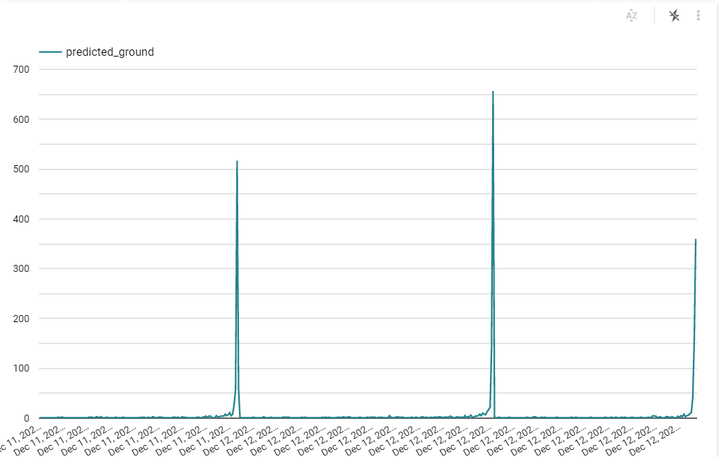
Predicted Onground
There are several spikes of on-ground flights across time

Slide 26
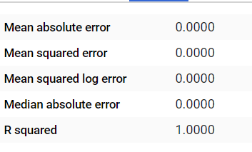
Model creation and evaluation for the Twitter Activities
CREATE OR REPLACE MODEL `tweeter.tweets_byday`
OPTIONS
(model_type='linear_reg', input_label_cols=['quotes']) AS
SELECT
created_at as create_time, quote_count as quotes, reply_count as replys, retweet_count as retweets
FROM `twitter-298321.tweeter.tweets_corrected`;

Slide 27
Model Prediction and Evaluation for the Twitter Activities
SELECT * FROM ML.predict(MODEL `tweeter.tweets_byday`,
(SELECT
created_at as create_time, quote_count as quotes, reply_count as replys,
retweet_count as retweets
from `twitter-298321.tweeter.tweets_corr_new`
LIMIT 100))
Judging from the R^2 scores for the training and test data sets, R^2 score decreases, which means that there is a better model that would predict quotes variable as opposed to the currently displayed one

Slide 28
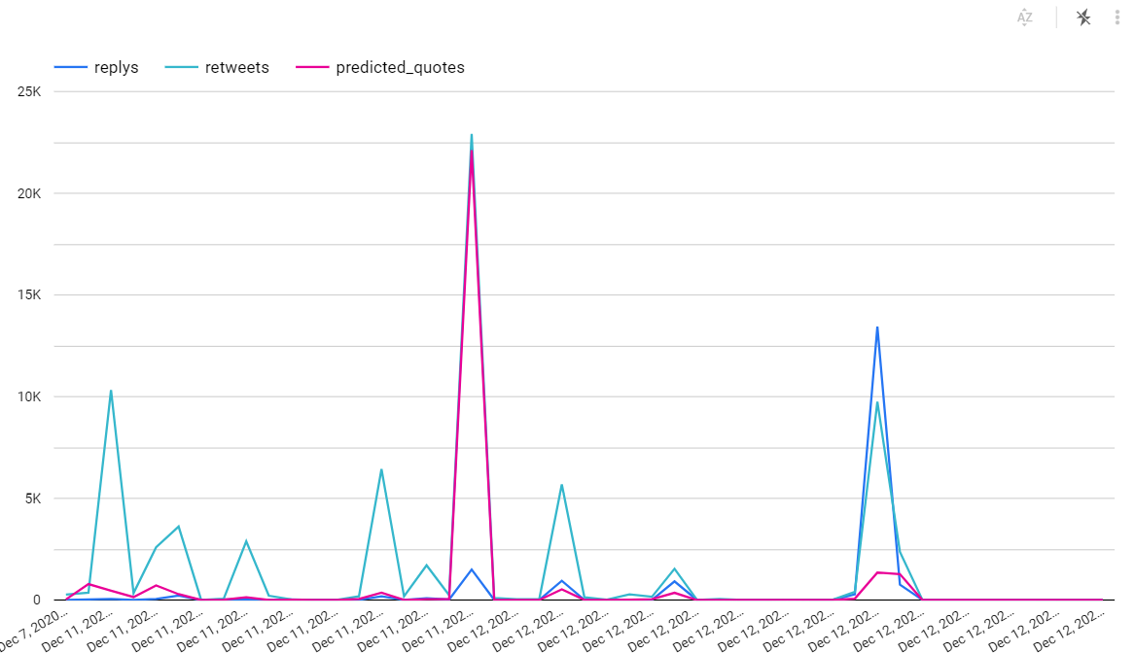
Twitter Activities by time
We firstly assumed there could be a correlation between flights on-ground and numbers of replies, retweets, predicted quotes on Twitter. That is, if more planes on the ground due to delays, we may be able to see more Twitter activities. Although we learned that there are several spikes on both flights and Twitter activities, we could not see an observable pattern between the two graphs, which means that another variable(s) can better explain Twitter activity spike

Slide 29
DataStudio Link
https://datastudio.google.com/u/0/reporting/9a0c4b80-6b40-411c-b7a7-50d42a34def2/page/7V2sB

